Slide 1


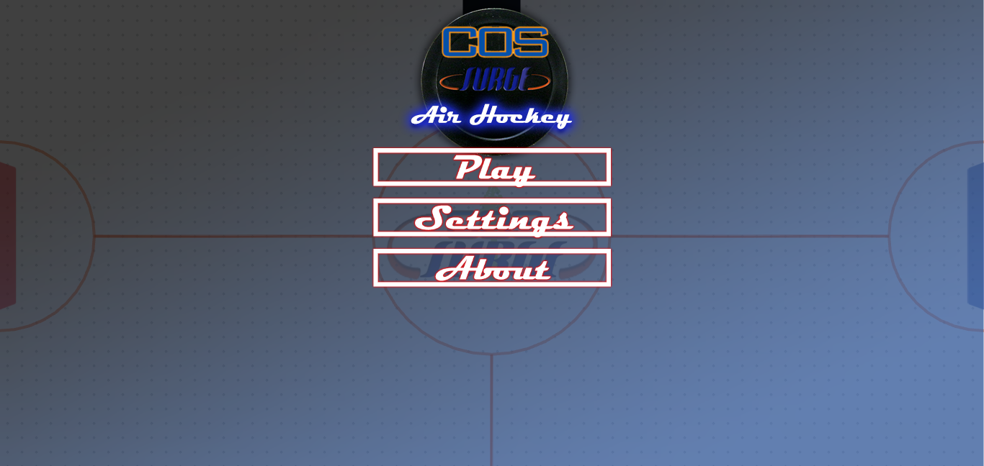

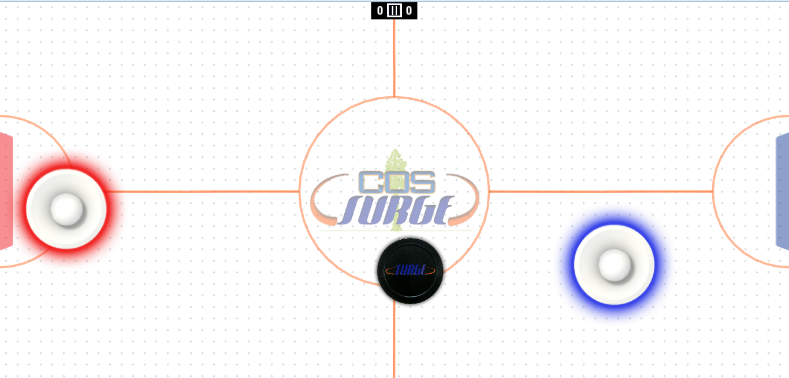
Game Table & Air Hockey Game John Redden, Cory Lewis, Paul Becera Gonzales, Gerald Jumper, Martin Garcia,
¹College of the Sequoias, & California State University, Fresno
²College of the Sequoias & California State Polytechnic University, Pomona
³Natural Resources Conservation Service, United States Department of Agriculture
Air Hockey Game
Multi-Purpose Game Table
HTML 5 Hybrid App
Design a game that is mobile friendly and can accept multiple touch inputs on a touchscreen monitor.
Links To Game:
Browser: cdn.rawgit.com/johnRedden/AirHockeySurge/master/www/index.html
Play Store: (1)Go to Google Play Store (2) Search “Air Hockey Surge”
Built Gaming Computer
Repurposed Table from the Tulare County Surplus Store
Design Tilting function on table
Test Touch system
Air flow designs
Mobile friendly
Designed to support VR functionality
Game Testing
Mobility Testing
Components Used in Design
Challenges
Phaser.js
HTML5 Game Engine
IntelXDK
Compiles HTML5 game to an APK file
Emulates Android devices (for testing)
GitHub
Syncs changes to multiple developers
Allows project to be accessed by users to test
Photoshop
Create art for game
There were several challenges that we had to overcome:
The singleplayer’s AI.
Fixing the game table to be user-friendly.
Importing sound and music files while lowering load times.
Switching between portrait and landscape without messing up the game
Making it mobile friendly
Working with a large group
Making it into a mobile app
Acknowledgements
Special thanks to: The SURGE Program, John Redden, Dr. Lawrence Owens, Duane Goodwin.
Funding for this project was provided by the College of the Sequoias SURGE program, which is funded by the US Department of Education MSEIP grant #P120A130106.

